Slide 1

KOSS Selection Task
NEW GIT CONCEPTS
By- Parag Karanjekar 21IE10021

Slide 2
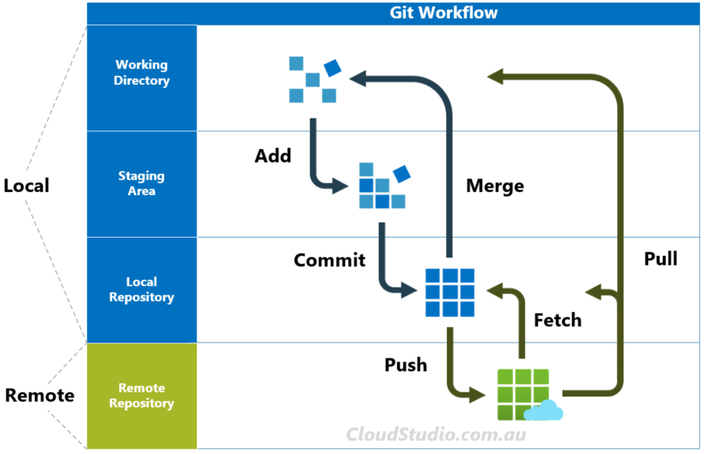
Introduction
GIT is a distributed version control that support distributed non linear workflows by providing data assurance from developing quality software it lets you and your team of developers work together on the same project form anywhere team members work on files and easily merge their changes into one source.
Often though, developers only learn a few simple commands and overlook the power of Git history and the other things that Git can do to make you much more efficient.

Slide 3
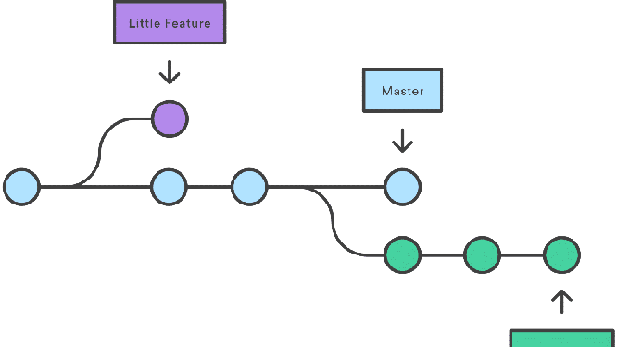
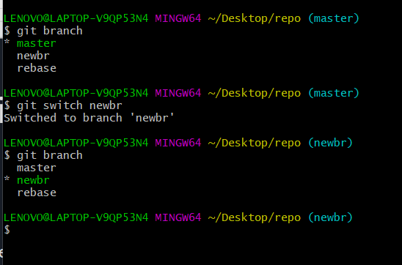
#1 git switch
This command is used to switch between different branches.
Terminal command to switch to a different branch is —> git switch <branch_name>
Switched form the master branch to the newbr using the
git switch command

Slide 4
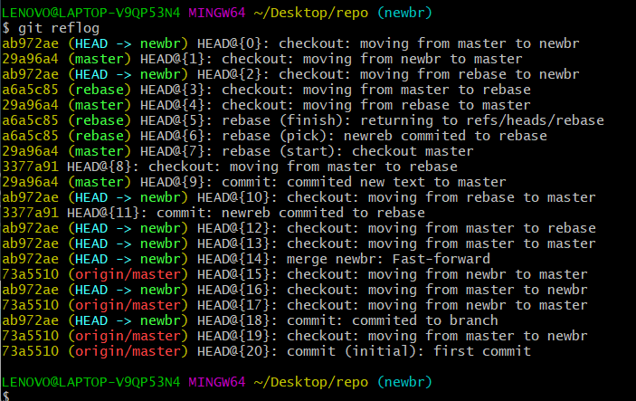
#2 git reflog
Its a journal where git logs every movement of the head pointer. Movement of the head pointer is when you commit, checkout merge , rebase cherry pick reset and all other actions and these are documented in the reflog.
It can be used to get log of all actions or actions in a particular branch

Slide 5
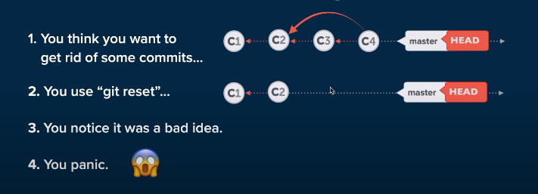
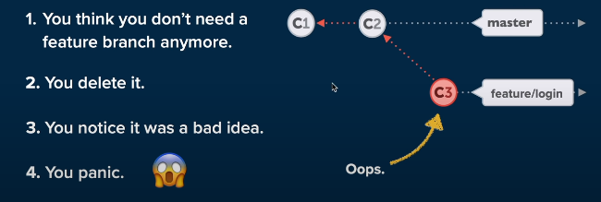
Scenario where git reflog is a saviour
In this case we can use the hash code and git reset to get back to a earlier state.

Slide 6
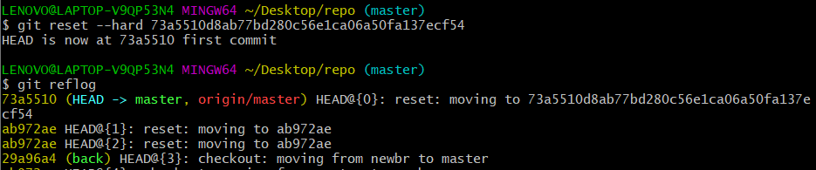
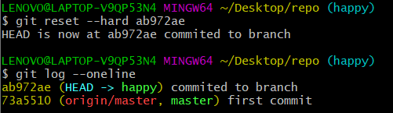
In the example below a deleted commit has been recovered back using hash code from the reflog

Slide 7
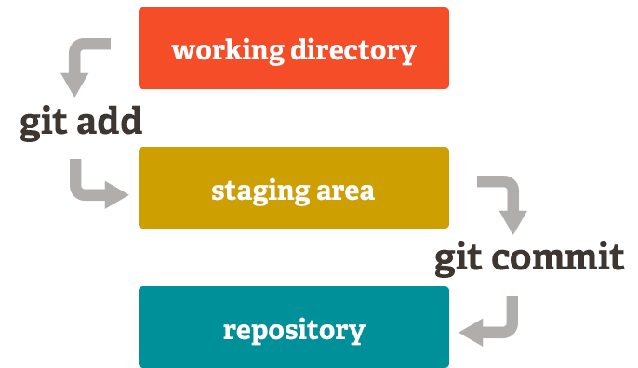
#3 git diff
Used to compare files in git repository. In different stages
Command is written as
git diff <file_name> to check differences in staging area and working directory file.
git diff HEAD <file_name> for working dir and latest commit
git diff –staged HEAD <file_name> for staged and latest commit

Slide 8
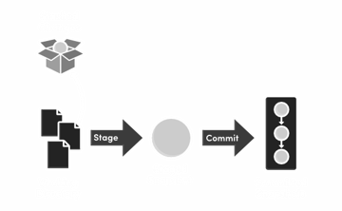
#4 git stash
Git stash enables you to save your code without making a commit. This can be accessed even after switching branches.

Slide 9
When you run git stash, the uncommitted code disappears without being committed. Stashing is like saving a temporary local commit to your branch. It is not possible to push a stash to a remote repository, so a stash is just for your own personal use.
Git stash common commands
git stash → Temporarily stores all modified tracked files..
git stash pop → restores the most recently stashed files.
git stash list → lists all the stashed changesets.
git stash drop → discards the most recent stashed files.
git apply stash@{<stash_index>} → bring back any particular stashed item

Slide 10
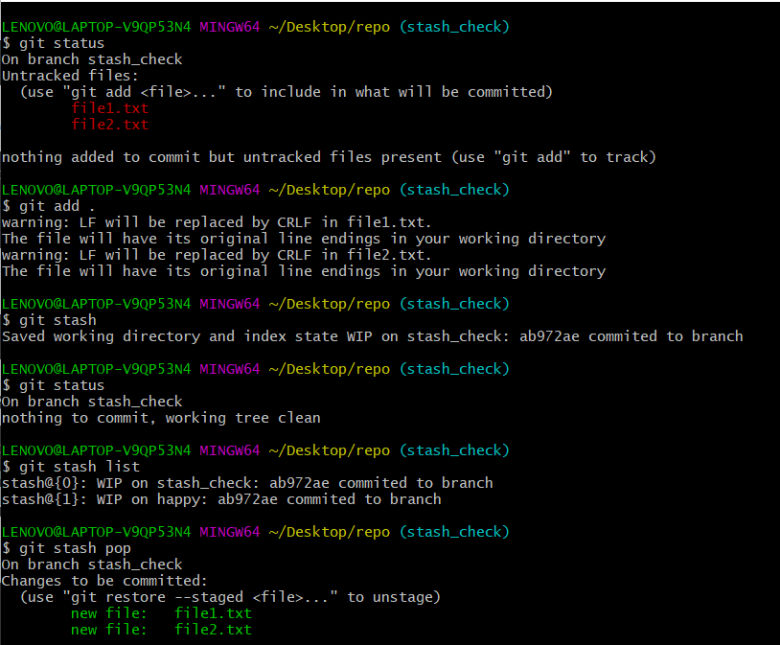
Here in this example two files in the staging area are stashed and then popped back to the staging area.

Slide 11
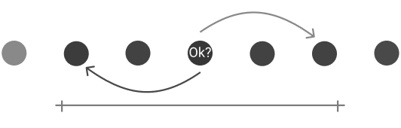
#5 git bisect
git bisect essentially performs a binary search between two given commits and then presents you with a specific commit details. You first need to give Git a good commit, where you know your functionality was working, and a bad commit.

Slide 12
How to perform git bisect
Start with git bisect start
And mark if the current commit is good or bad using git bisect bad/good
If it is bad then using git log find the hash of the last commit you remember to be a good one then use the command git bisect good <hash_code>
Then mark the next commit as good or bad and repeat this step until you find the first bad commit.

Slide 13
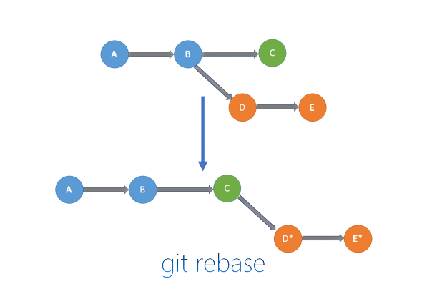
#6 git rebase
git-rebase: Applies commits on top of another base tip If you don’t care about your git commit history, git rebase won’t be useful, but if you would prefer a clean, linear history free of unnecessary merge commits, you should reach for git rebase instead of git merge when integrating changes from another branch.
Git rebase makes the branched changes linear.

Slide 14
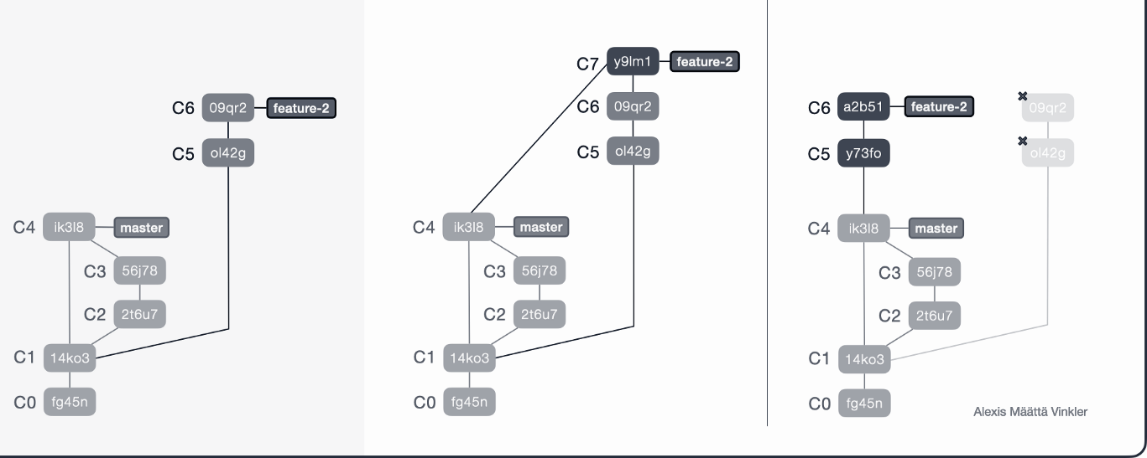
git rebase vs git merge
Starting branches git merge git rebase

Slide 15

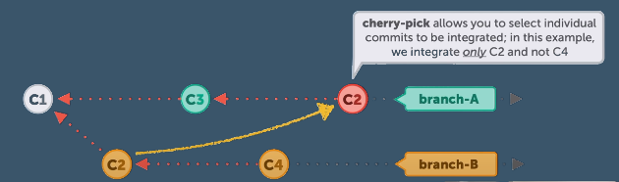
#7 git cherry-pick
When we need to apply the commits from different branches we use git rebase or git merge but in a situation where we want a particular commit to be present on other branch git cherry-pick comes handy, it helps us to “cherry pick” a particular commit from one branch and apply it to the other branch.

Slide 16
THANK YOU

